Slide 1




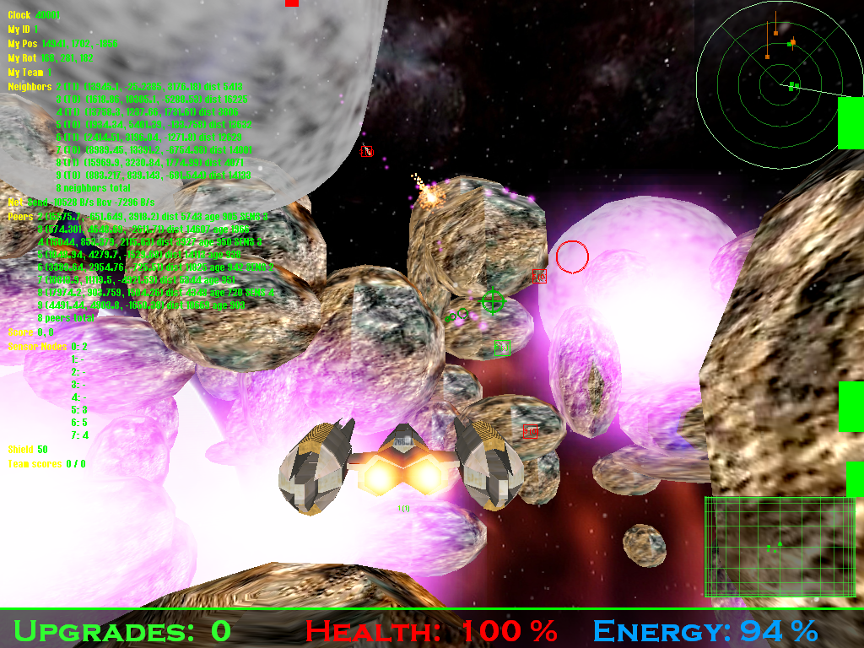
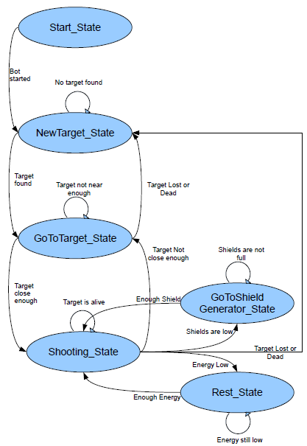
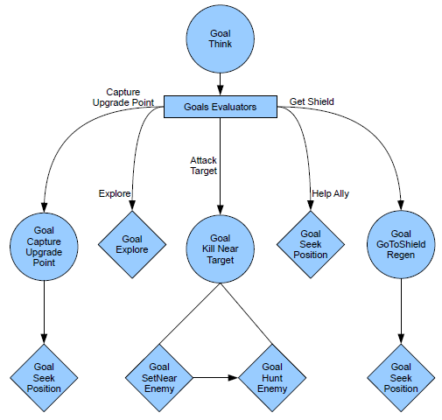
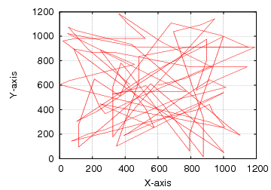
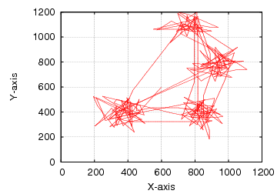


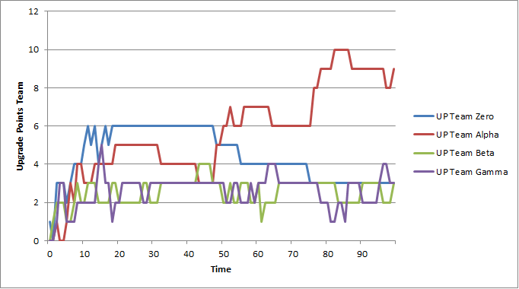
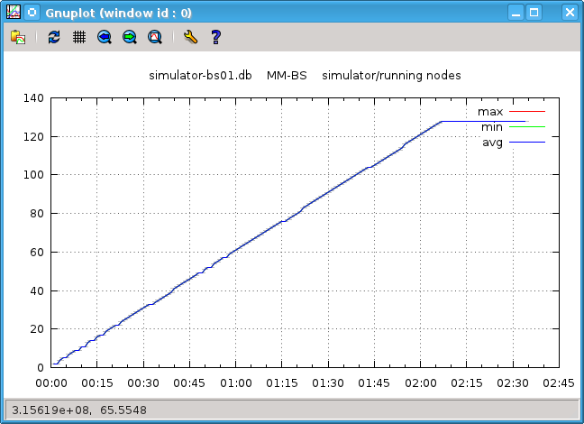
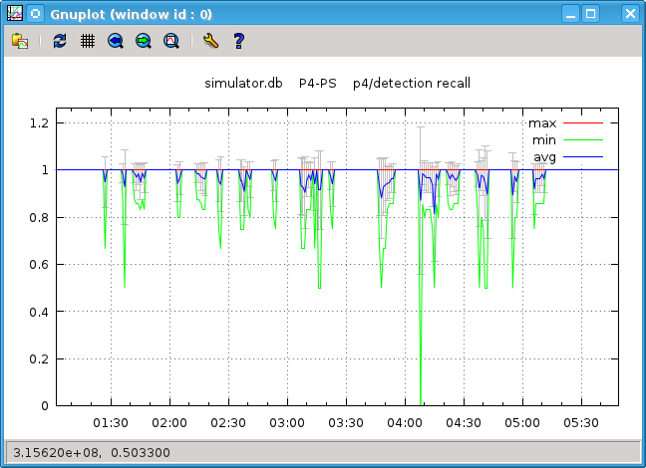
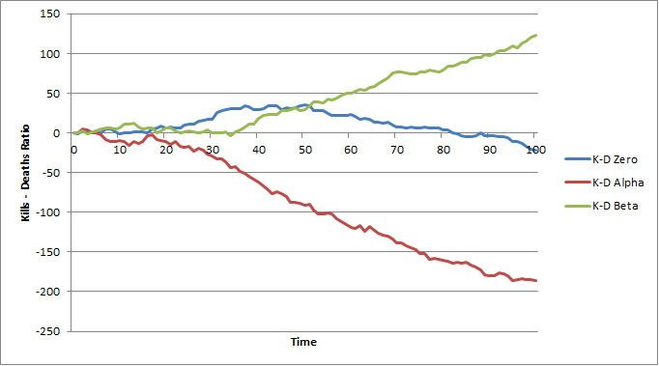
 | An Online Gaming Testbed for Peer-to-Peer Architectures
 | Max Lehn, Christof Leng, Robert Rehner, Tonio Triebel, Alejandro Buchmann
Introduction
Goal: Provide a scalable testbed for P2P gaming mechanisms
Requirements:
Gameplay representing a real game
Attractive game to real players, which provide the reference behavior
Simple enough for focusing on the important aspects
Run in a real network as well as in a deterministic emulated network environment
Resource-efficient for a good simulation scalability
Well-defined and flexible interfaces to facilitate the replacement of network components
Bots
Reproducible game workload generation
Simulate human user behavior
Implementations using finite state machines (FSM) or
behavior trees (BT)
Bot
Bot
GUI
Simple Mobility Model
Simple & lightweight
Not simulating whole gameplay
→ higher scale, faster simulation
Simple extensibility
E.g. random waypoint model, special movement patterns, traces (other games)
Gameplay
Planet PI4 is a prototype of a 3D real-time massively multiplayer online game
Competing teams
Asteroid field sets the effective game world: parametrizable, random-generated
Points of interest (POI): bases, upgrade points
Rewards for capturing bases
Planet PI4 Game
Mobility Model
Network Engine
Spatial Multicast
Object Management
Network: Object Management
Persistent storage
Object lookup
Concurrent modification / synchronization
Enables bases, NPCs, etc.
Instances:
Colyseus [4],
VSM [5]
Channel Pub/Sub
Global State
Network: Spatial Multicast
Dissemination of game events in a spatial context
Interest management
and multicast
Instances:
VON [1],
pSense [2],
pSense-3D,
client/server
Legend:
Objects
Participants
Simulation Engine
Native Network Runtime
vision range
Native Runtime
Real-time, real network
For human players
User studies:
generate traces, calibrate bot behavior
Simulation Engine [3]
Discrete-event simulation
Packet level network interface (UDP)
Custom overlay simulator, alternatively ns-3
Statistics interface, live plotting from SQLite database using gnuplot
References:
Hu S-Y, Chen J-F, Chen T-H. VON: a scalable peer-to-peer network for virtual environments. IEEE Network. 2006;20(4):22–31.
Schmieg A, Stieler M, Jeckel S, et al. pSense - Maintaining a Dynamic Localized Peer-to-Peer Structure for Position Based Multicast in Games. In: P2P’08. Eighth International Conference on Peer-to-Peer Computing. 2008:247–256.
Leng C, Lehn M, Rehner R, Buchmann A. Designing a Testbed for Large-scale Distributed Systems. In: SIGCOMM’11: Proceedings of the 2011 conference on Applications, technologies, architectures, and protocols for computer communications. 2011.
Bharambe A, Pang J, Seshan S. Colyseus: A Distributed Architecture for Online Multiplayer Games. In: Proceedings of the 3rd conference on Networked Systems Design & Implementation (NSDI’06). Berkeley, CA, USA: USENIX Association; 2006.
Hu S-Y, Chang S-C, Jiang J-R. Voronoi State Management for Peer-to-Peer Massively Multiplayer Online Games. In: Proceedings of the 5th IEEE Consumer Communications and Networking Conference (CCNC’08). 2008:1134–1138.
Contact: Max Lehn, mlehn@dvs.tu-darmstadt.de | http://www.dvs.tu-darmstadt.de/

