Slide 1


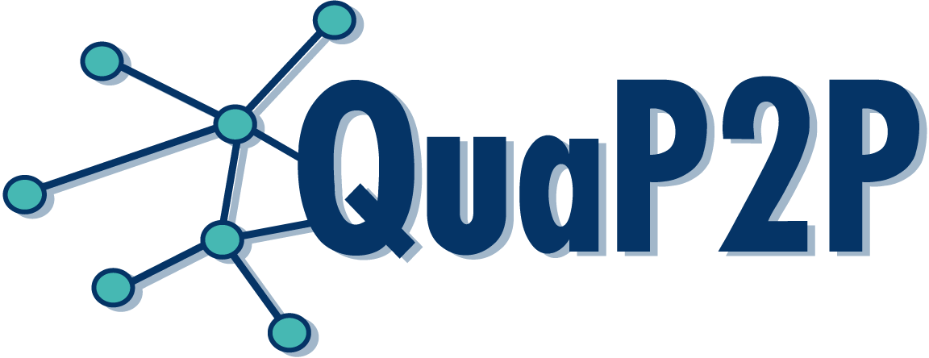

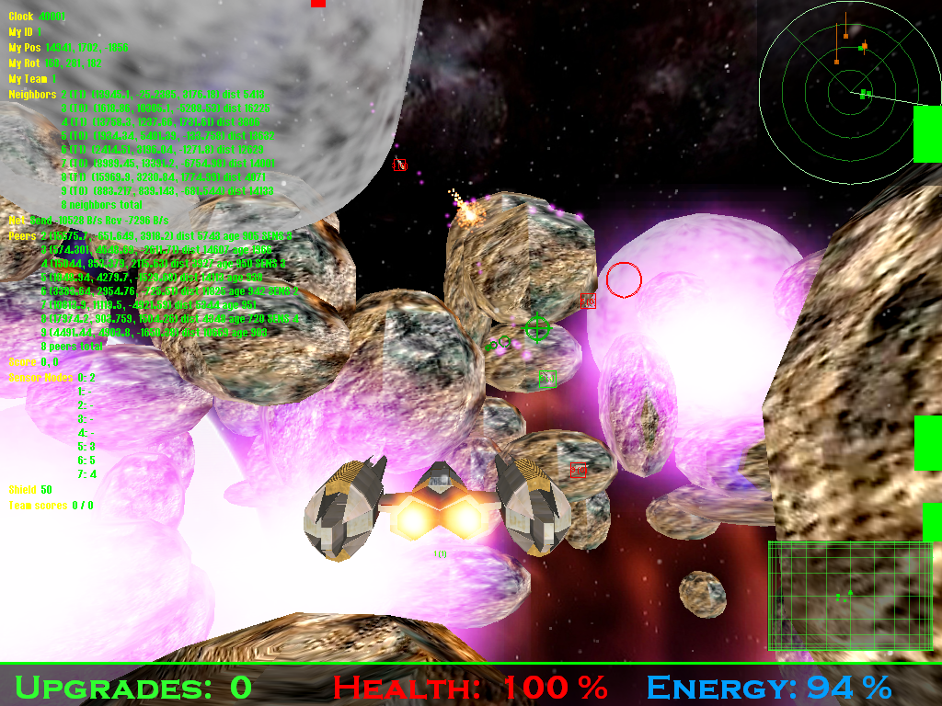
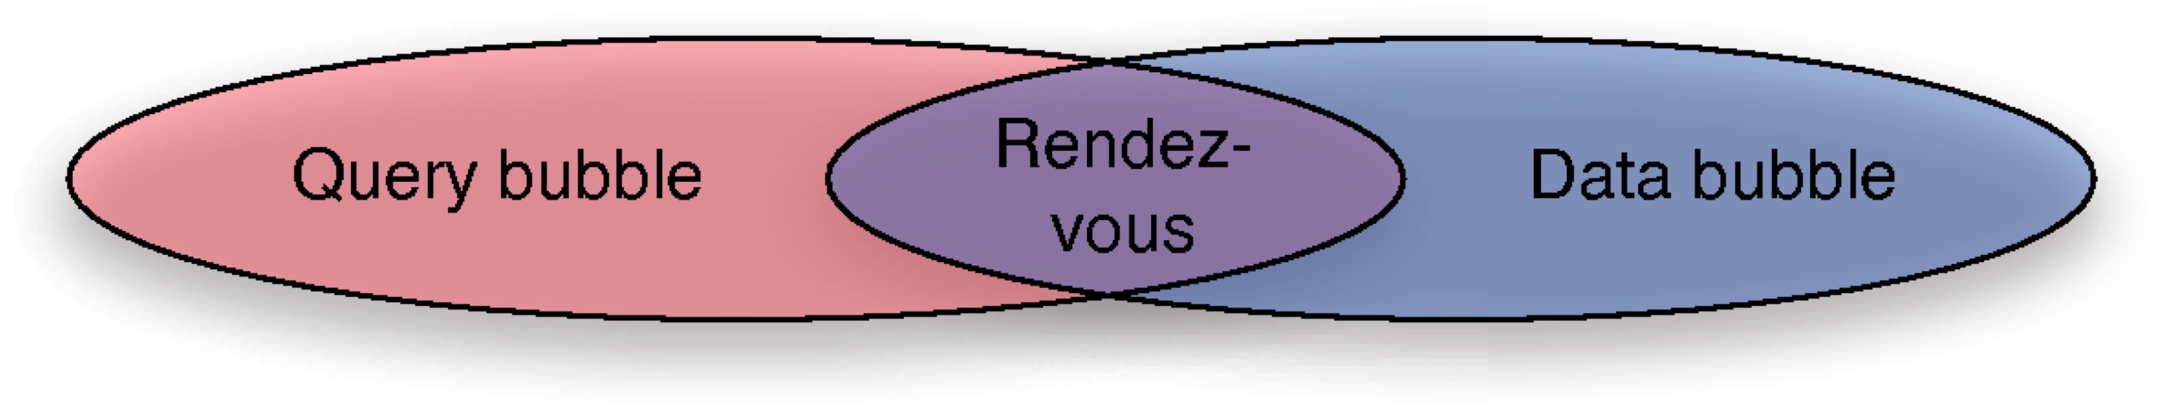
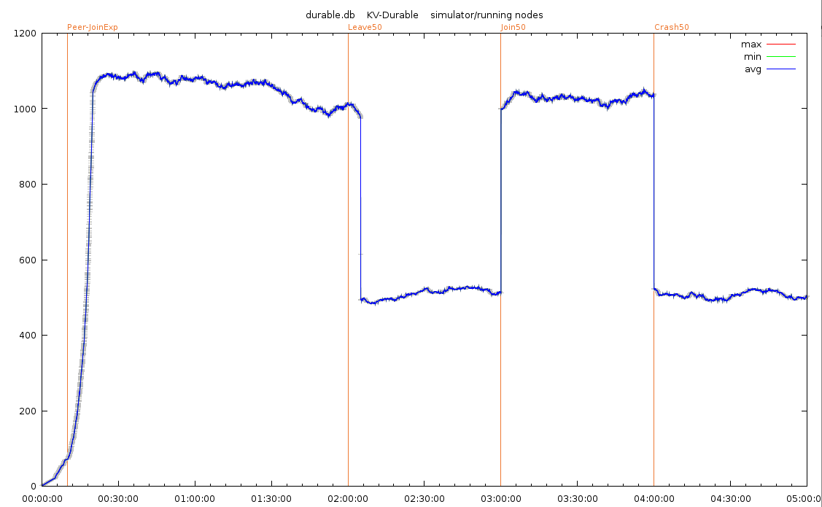
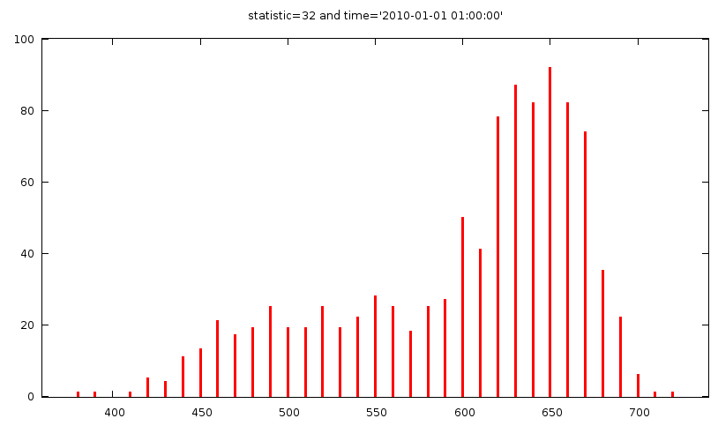
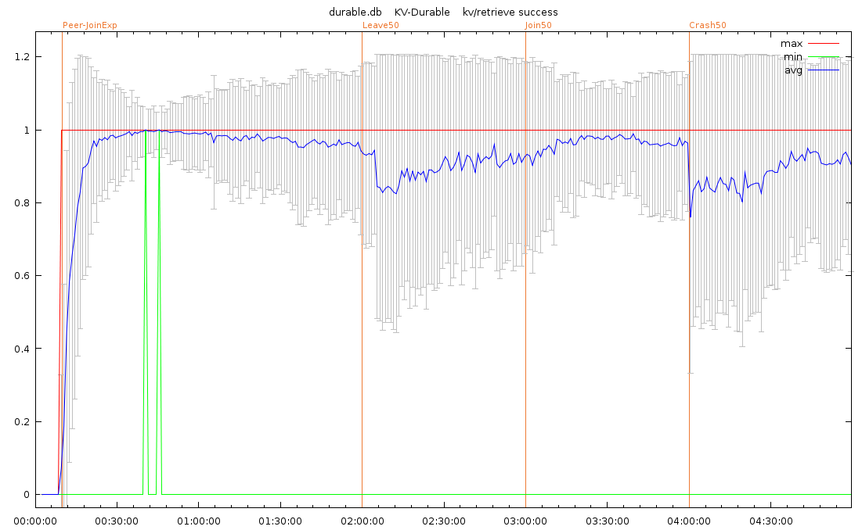
 | Designing a Testbed for Large-scale Distributed Systems
 | Christof Leng, Max Lehn, Robert Rehner, Alejandro Buchmann
Workload Generation
Configured in the experiment database
Sophisticated session model
  Background churn determined by lifetime distribution [1]
  Workload events to mark nodes as
  active or inactive
Support for Unix signals to trigger application-level events
Approach
Flexible framework for prototype development and scientific evaluation of distributed applications
Interchangeable runtime engines for simulation and real-world deployment
Narrow system interface separates application from runtime
Versatile experiment database for experiment configuration and output analysis
Experiment Database
Experiment configuration and output in the same database file (using SQLite)
Flexible experiment configuration
Statistics and histogram data for plotting
Rich log output for post-mortem debugging
Connection
Name
Downstream
Upstream
Buffer
Last Hop Delay
Message Loss
Node Group
Name
Connection
Location
Static Address
Crash Ratio
Lifetime Distribution
Node Configuration
Experiment
Node Group
Fixed Size
Rem. Weight
Workload
Command
Workload
Name
Event Name
Type
Time
Percentage
Example Applications
Supports peer-to-peer and client/server applications
Language support for Standard ML, C/C++, and Java
Event-driven, single-threaded applications can be ported easily
Log Filters
Experiment
Module
Level
Nodes
Experiment
ID
Node Group
Location
Address
Experiments
Name
Size
Runtime
Seed
DNS
Experiment
Hostname
IP
Workload Generator
Log
Experiment
Node
IP
Module
Level
Time
Message
Histograms
Statistic
Time
Bucket
Width
Count
Statistics
Experiment
Name
Node
Measurements
Statistic
Time
Count
Min
Max
Sum
Sum²
Network Application
BubbleStorm [2]
Search Overlay
Planet PI4 [3]
Online Shooter
System Interface
SQLite
Data
base
CUSP Transport Protocol
Complete user-land transport protocol implementation [4]
Containing flow control, congestion control, reliability, priorities/QoS, encryption, authentication
Encapsulated over UDP
Simplifies simulator implementation (simulator only needs UDP support)
Powerful tool for the implementation of novel network applications
CUSP Transport Protocol
Integrated Plotting Tools
Plot directly from experiment database using Gnuplot scripts
Live plotting during simulation run
Main/Events
Network
(UDP)
Entropy
Log / Statistics
Runtime Engine
Real Network
ns-3
Overlay Simulator
Gnuplot
System Interface
Narrow system interface that abstracts from runtime
  Easy to learn for application developers
  Simple to implement new or extend existing runtimes
Main interfaces:
Exchangeable Runtime Engines
Custom overlay simulator
  Scalable to 10k+ nodes
  Coordinate-based delay model [5]
  Send/receive queues with limited bandwidth
  SQLite database for log/statistics
ns-3 simulator [6]
  Full network stack simulation
  Community standard network simulator
Real network
  Real-time main loop
  Operating system’s network stack
  /dev/urandom for entropy
  Logging to stdout/stderr
  Validate simulation results
References
[1] Konstantin Pussep, Christof Leng, Sebastian Kaune. Modeling User Behavior in P2P Systems. In Klaus Wehrle, Mesut Günes, James Groß: Modeling and Tools for Network Simulation, ISBN 978-3-642-12330-6, Springer, July 2010
[2] Wesley W. Terpstra, Jussi Kangasharju, Christof Leng, Alejandro P. Buchmann. BubbleStorm: Resilient, Probabilistic, and Exhaustive Peer-to-Peer Search. Proceedings of the 2007 ACM SIGCOMM Conference, Kyoto, Japan, August 2007
[3] Max Lehn, Christof Leng, Robert Rehner, Tonio Triebel, Alejandro Buchmann. An Online Gaming Testbed for Peer-to-Peer Architectures. Proceedings of ACM SIGCOMM'11, Toronto, Canada, ACM, August 2011
[4] Wesley W. Terpstra, Christof Leng, Max Lehn, Alejandro P. Buchmann. Channel-based Unidirectional Stream Protocol (CUSP). Proceedings of the IEEE INFOCOM Mini Conference, March 2010
[5] Sebastian Kaune, Konstantin Pussep, Aleksandra Kovacevic, Christof Leng, Gareth Tyson, Ralf Steinmetz. Modelling the Internet Delay Space Based on Geographic Locations. Proceedings of the 17th Euromicro International Conference on Parallel, Distributed, and Network-Based Processing (PDP 2009), Weimar, Germany, February 2009
[6] Thomas R. Henderson, Sumit Roy, Sally Floyd, George F. Riley. ns-3 project goals. Proceeding of the 2006 workshop on ns-2: the IP network simulator (WNS2 2006), Pisa, Italy, October 2006
Main
Run
Stop
Signal
Entropy
Get
Log
Log
Print
Event
New
Schedule At
Schedule In
Cancel
Time
UDP
New
Close
Send
Recv
SendICMP
RecvICMP
Statistics
New
Add Poll
Add
Contact: Christof Leng, cleng@dvs.tu-darmstadt.de | http://www.dvs.tu-darmstadt.de/

